Slide 1
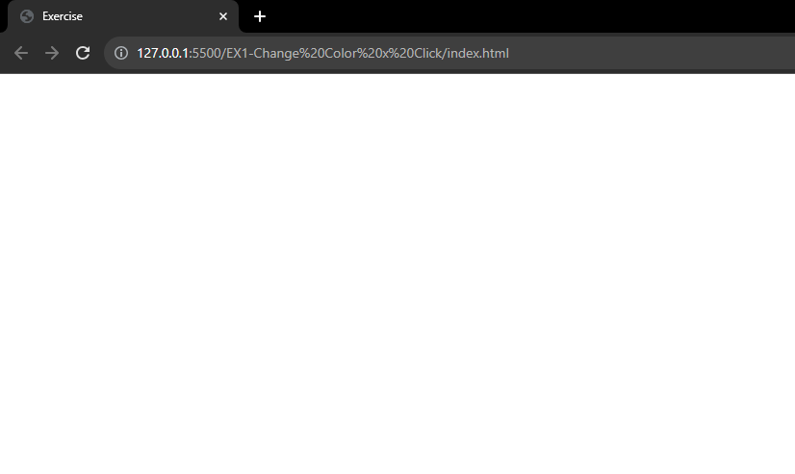
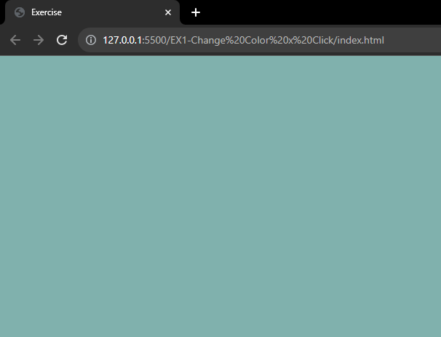
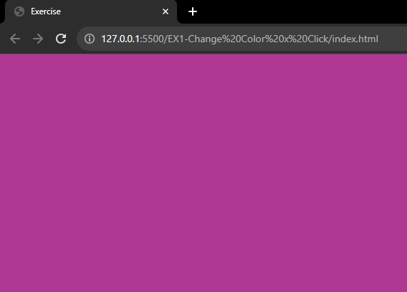
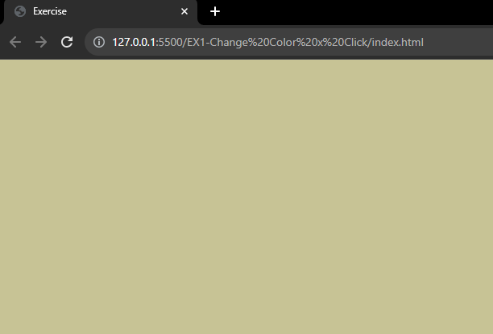
Exercise 1
Click to change color
Once you click the browser screen the color is changed
The color code is generated by random.

Slide 2
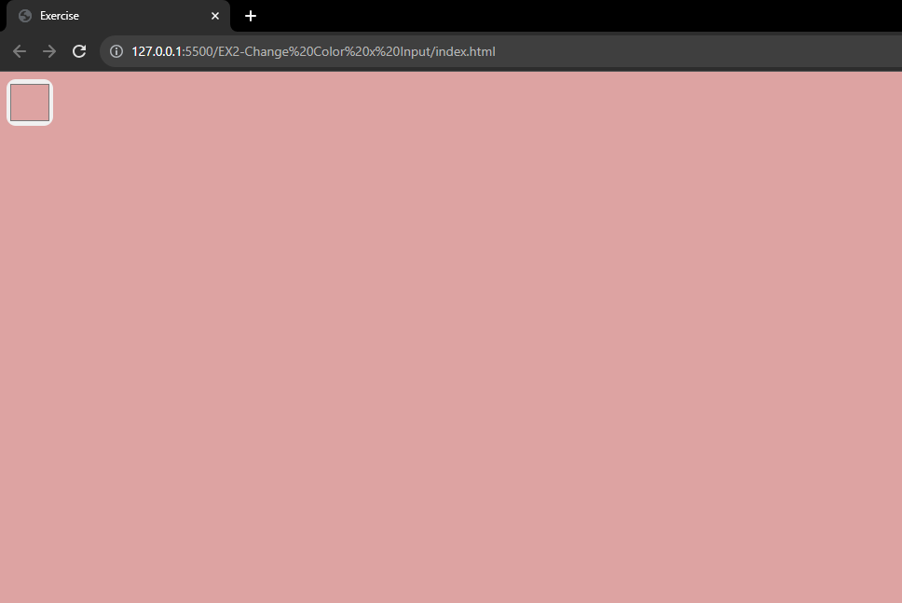
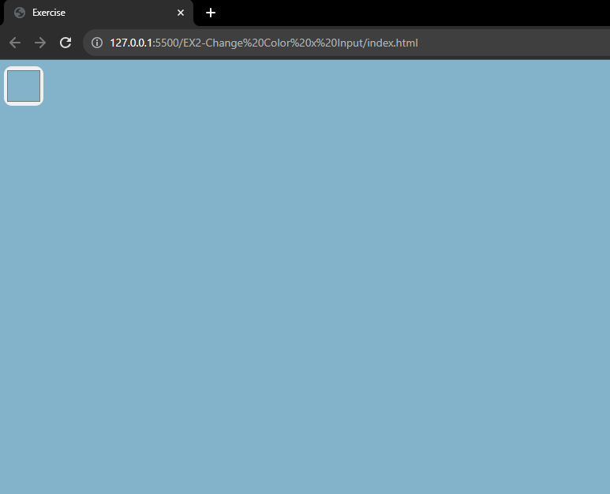
Exercise 2
Pickup to change color
Once you changed the color on input type color the background is changed to that color.

Slide 3
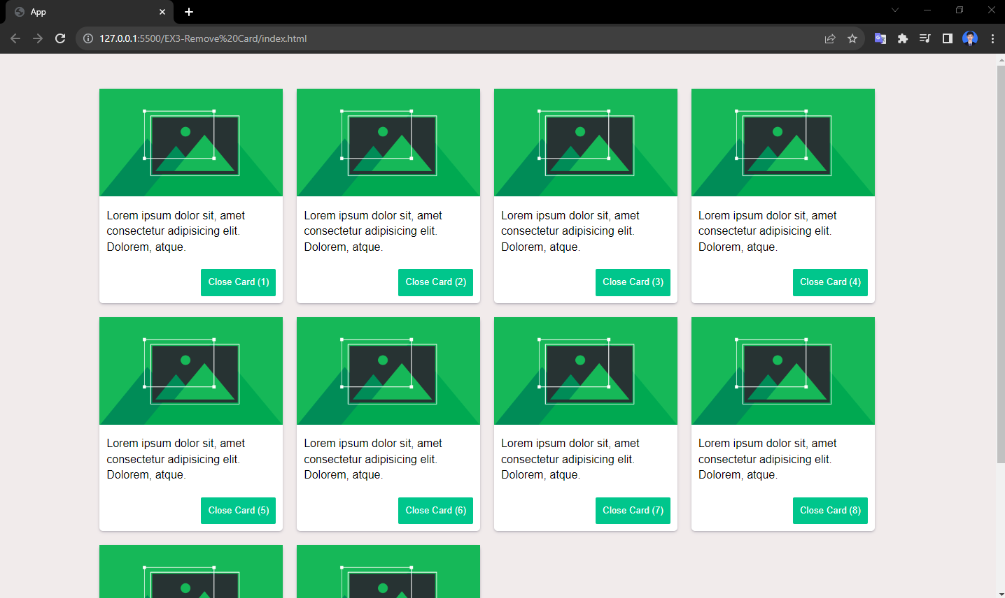
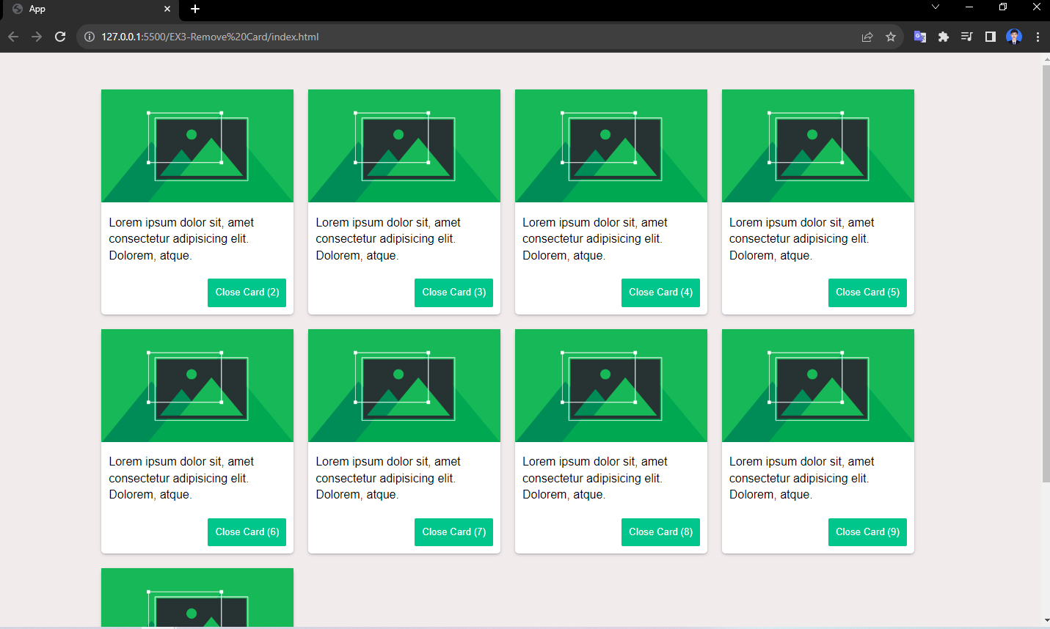
Exercise 3
Close card
When we click the card button to close the card is removed.

Slide 4
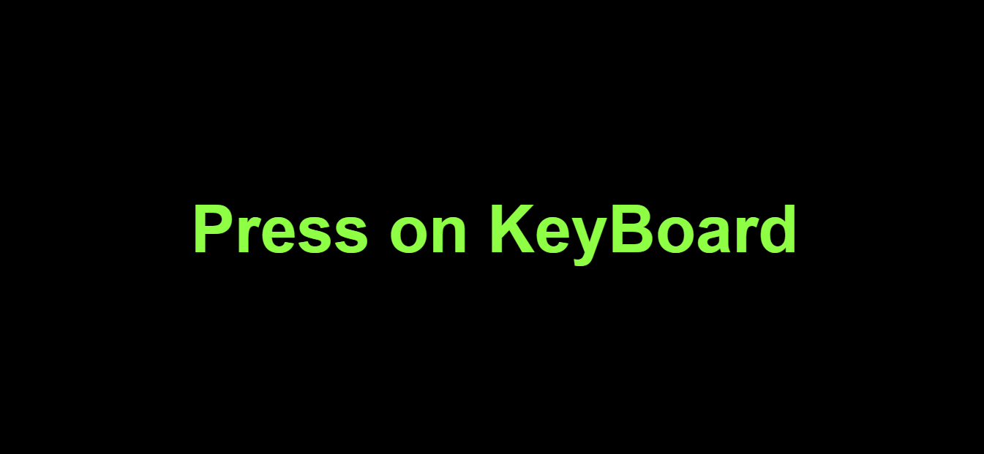
Exercise 4
Press on key
Once you click on any keyboard the name of key will show on the screen.
a
b
c
control
Alt

Slide 5
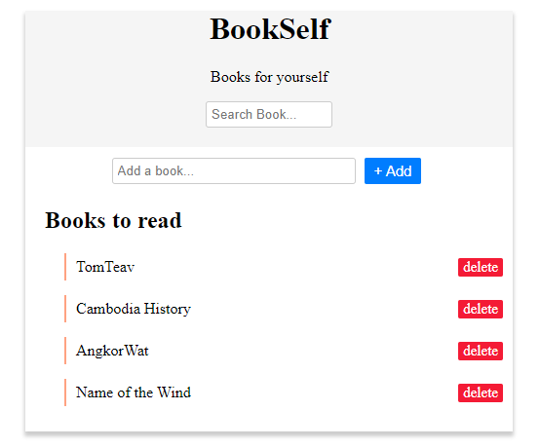
Exercise 5
Book List
Check the existing instructions on the exercise.

